Slide 1
China Rail Travel Planner
By: Tongze Wong(Project Owner), Zhaoheng Chen Howard Ho Wai Ng
supervised by Dhawal Joharapurkar(TA)

Slide 2
Questions
- Assume users have a ${number}-day vacation, where can the users go and visit?
- Assume users have a ${number}-dollar budget, where can the users go and visit?
- Assume users have a ${number}-day vacation and ${number}-dollar budget, where can the users go and visit?

Slide 3
Data Sources & References
Data sources:
12306.cn: Official website of China Railway. Schedule of a specific train station
IP138.com: Schedule of a specific train
GPSSPG: Retrieve coordinates of every train station
Visualization:
Echarts: Geo component example
China Railway Map: Railway map

Slide 4
Question Answered & Visualization
All questions are answered and visualized with an interactive webpage:
https://howardng940990575.github.io/CSE184-Final-Project-Railroad-Travel-React/

Slide 5
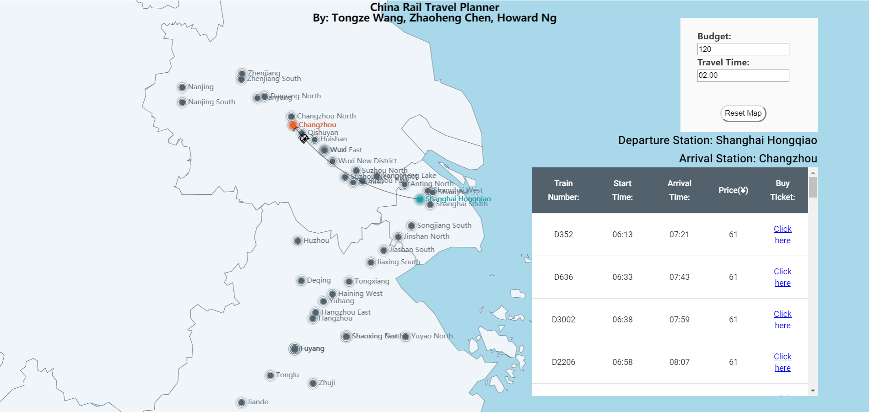
Visualizations

Slide 6
Libraries Used
Web scripting:
Python 3: beautifulsoup4, JSON, requests, re, numpy, pandas
Visualization:
React:Create the interactive webpage
Echarts-for-react:The map component of the webpage
React-gh-pages:Publish the react app to the github page

Slide 7
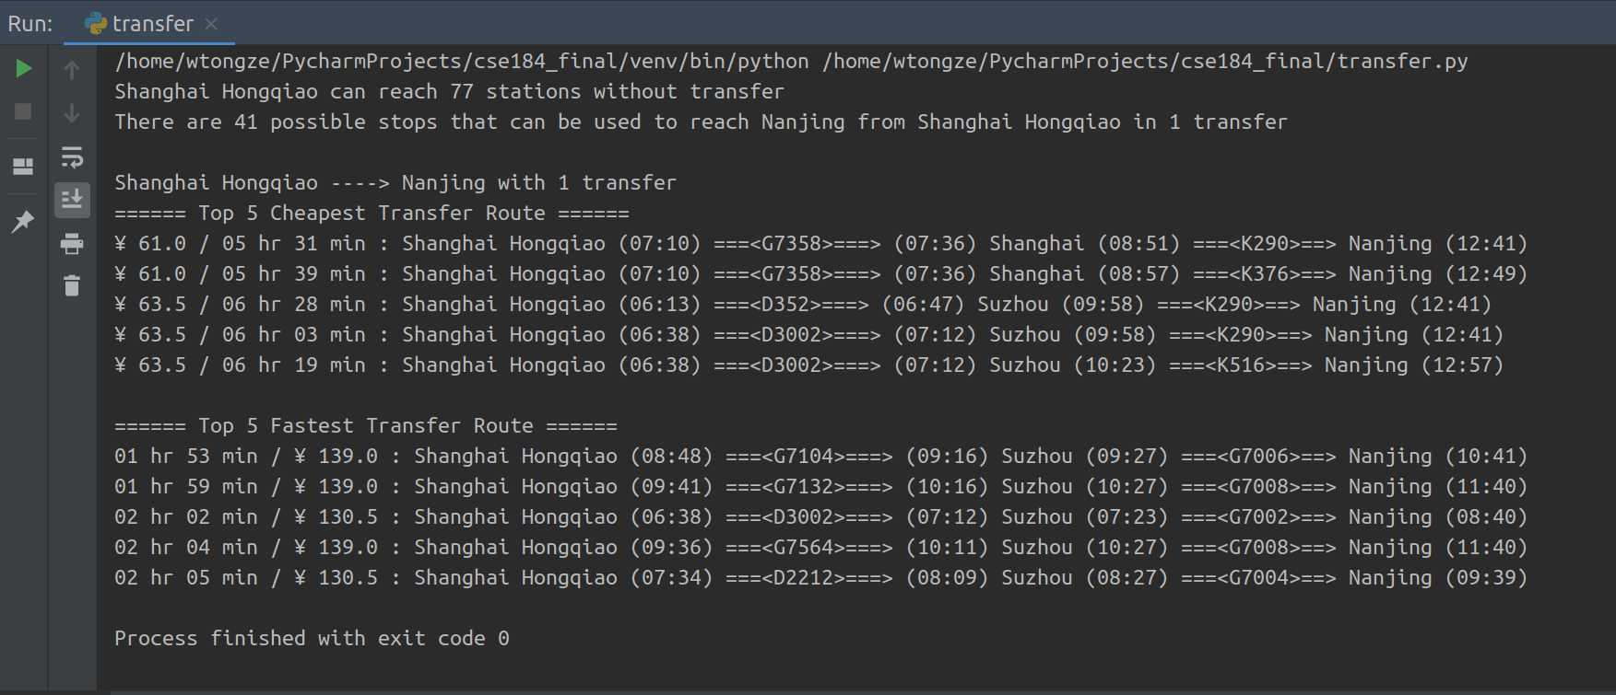
Transfer Search Algorithm - (Extra Part)

Slide 8
Contributions
Tongze Wang: back-end
Scrapped, cleaned and wrangled all train data from the official website of China Railway and Stored into a single JSON file.
Build the beta version of the train transfer searching algorithm.
Zhaoheng Chen & Howard Ng: Front-end
Visualized the data with an interactive webpage via React and echarts
Implement the reachable train stations algorithm and update the map
Implement the available trains algorithm and update the table
UI design for the interactive map

